Slide 1
Lecture 5: Local Area Networks
Ravi Mittal
ravi.mittal@iitgoa.ac.in
Indian Institute of Technology, Goa

Slide 2
Contents
Computer + Telecommunication = Datacom / Network
Network Requirements for Digital Transformation
Different types of Datacom Technologies
LAN
Ethernet
Computer Network Top level view – Interplay with the Internet

Slide 3
Computer and Communication Era begins
Great combination: Computing and Communication
Computer Networks
Wireline
Wireless
Telecommuni
-catio
Computing
Computer
Network

Slide 4
Network Requirements for Digital Transformation
High Connectivity
High bandwidth
Bandwidth on Demand
Real time communication – upper bound on delays
High Reliability
Low error rate
No packet loss
Manageability and Operation Support
Ease of installation, Maintenance, Configurability
Network Agility - Adaption to changing business needs
Low cost – affordability
Security
Support for many low level protocols and technologies

Slide 5
What are different types of Datacom technologies?

Slide 6
Telnet
SMTP
IP
Ether- net
VPN
HTTP
VLAN
DNS
DNS
UDP
DNS
DNS
ARP
ATM
DNS
DNS
FR
SONET
DNS
PPP
DNS
GPRS
FTP
TCP
DNS
WiFi

Slide 7
Datacom / Networking Protocols
Distributed Protocols
Both ends of a wire or a path – run the same protocol
Hundreds of Networking Protocols
Many protocols are highly complex
Example: GSM

Slide 8
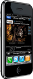















Today’s Network
mobile network
4G
national or global ISP
IP
Streaming
video
Skype
local or regional ISP
home network
content
provider
network
HTTP
datacenter
network
Ethernet
TCP
enterprise
network
WiFi
Source: Kurose and Ross Book: 8th Edition

Slide 9
Local Area Network (LAN)

Slide 10
Multiple ways of doing classification
Based on Locality
Local Area Network
Wide Area Network
Based on Access Technology
Wireline
Wireless
Based on Mobility
Non-mobile
Mobile

Slide 11
Local Area Network and DT
Local Area Network - Pervasive
Factories, Home, Offices, Shops, …even offices
Both wireline (Ethernet) and Wireless (WiFi)
Various Flavors of LAN
Within Cars : Vehicle Area Network (VAN)

Slide 12
Corporate Network

Slide 13
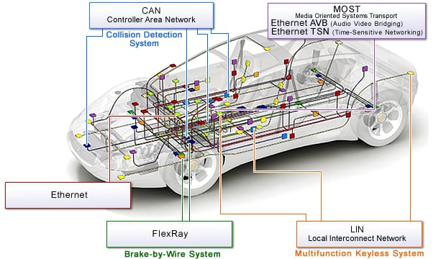
In-Vehicle Network (VAN)
Ref: In-Vehicle Networking Solutions, Renesas
:

Slide 14
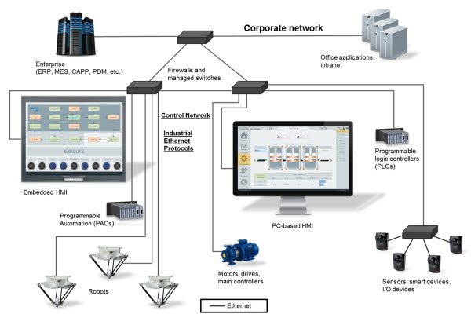
Industrial Ethernet
Image credit: AutomationDirect.com :

Slide 15
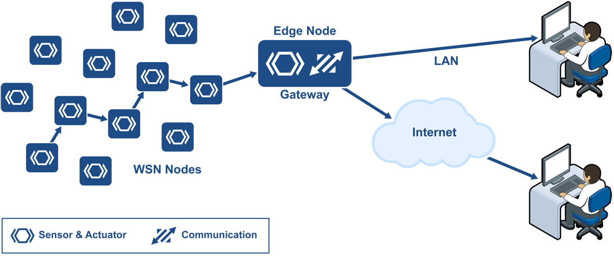
Many flavors of LANs
Ethernet IP
Powerlink
Ethercat
Wireless Sensor Network

Slide 16
Local Area Network (LAN): Ethernet

Slide 17
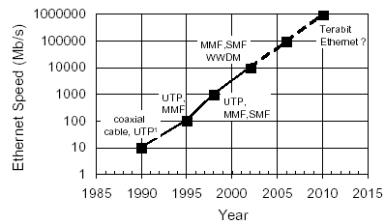
Ethernet: datalink layer technology
Ethernet dominated local-area networks for decades
Invented in 1973 @ Xerox. (IEEE 802.3)
Originally a LAN technology – now extended to MAN / WAN
Same frame format, different wiring schemes, data rates across generations

Slide 18
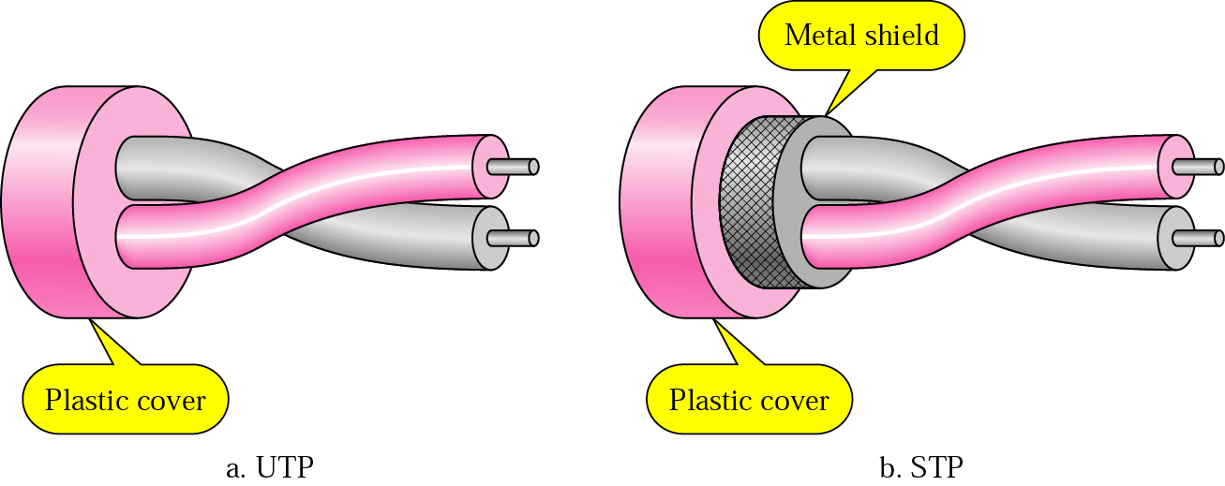
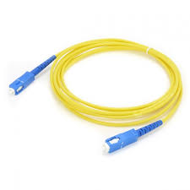
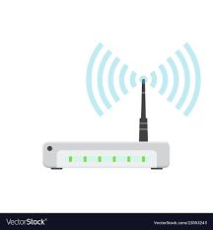
Physical Media for Ethernet
Fiber
Wireless

Slide 19
The Ethernet
The Ethernet is the most popular LAN technology
Packet switching
History
Developed by Bob Metcalfe and others at Xerox PARC in mid-1970s
Roots in Aloha packet-radio network
Standardized by Xerox, DEC, and Intel in 1978
LAN standards define MAC and physical layer connectivity
IEEE 802.3 (CSMA/CD - Ethernet) standard – originally 2Mbps
IEEE 802.3u standard for 100Mbps Ethernet
IEEE 802.3z standard for 1,000Mbps Ethernet
CSMA/CD Protocol
Carrier Sense Multiple Access Collision Detection

Slide 20
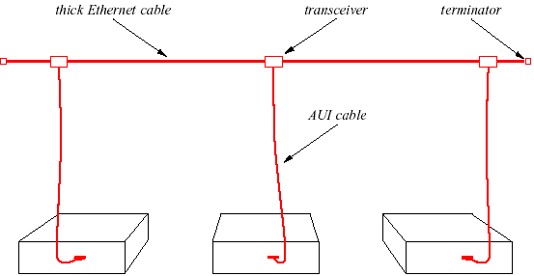
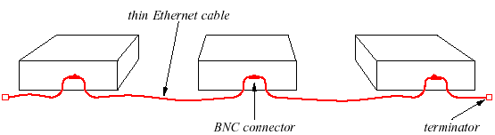
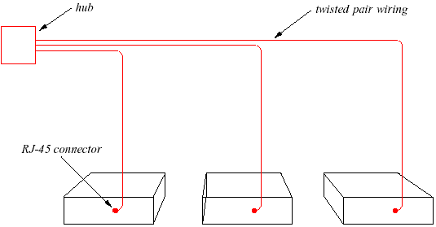
Ethernet Generations
Original Ethernet:
Coaxial cable (10Base5)
Thicknet.
Next Generation:
Thin coax cable (10Base2)
Thinnet.
Modern Ethernet:
Twisted pair ethernet (10BaseT)
Uses hub: physical star but logical bus.

Slide 21
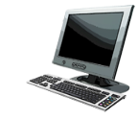
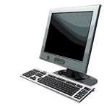

Ethernet Switches
active switch in center
each “spoke” runs a (separate) Ethernet protocol
No collision
switch
star
bus: coaxial cable

Slide 22
Gigabit Ethernet (1000 BASE X)
Provides speeds of 1000 Mbps (i.e., one billion bits per second capacity) for half-duplex and full-duplex operation.
Uses Ethernet frame format and MAC technology
CSMA/CD access method with support for one repeater per collision domain.
Backward compatible with 10 BASE-T and 100 BASE-T

Slide 23
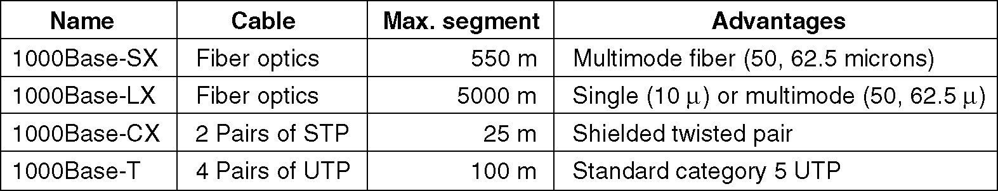
Gigabit Ethernet Technology
Gigabit Ethernet cabling.
1000 BASE SX fiber - short wavelength
1000 BASE LX fiber - long wavelength
1000 BASE CX copper - shielded twisted pair
1000 BASE T copper - unshielded twisted pair
Based on Fiber Channel physical signaling technology.

Slide 24
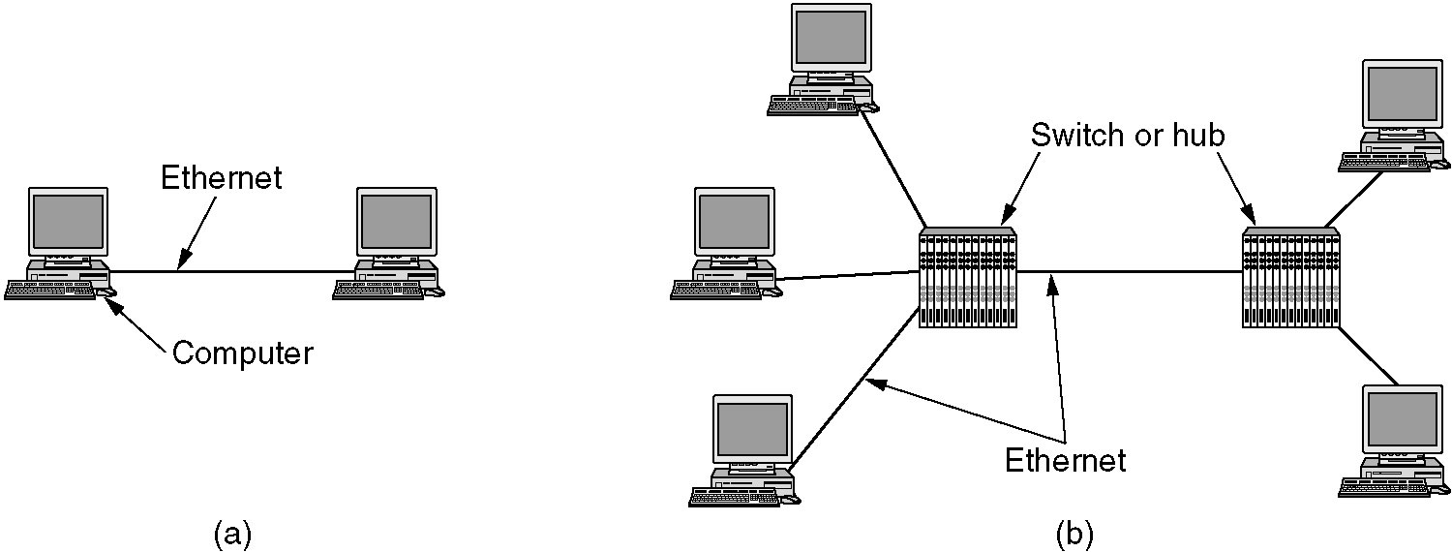
Gigabit Ethernet

Slide 25
Computer Network: Top level view

Slide 26
Ethernet Segment
host
host
host
100 Mb/s
100 Mb/s
hub
port
Ethernet segment consists of a collection of hosts connected by wires (twisted pairs) to a hub
Spans room or floor in a building
Operation
Each Ethernet adapter has a unique 48-bit address (MAC address)
E.g., 00:16:ea:e3:54:e6
Hosts send bits to any other host in chunks called frames
Hub slavishly copies each bit from each port to every other port
Every host sees every bit
Note: Hubs are on their way out. Bridges (switches, routers) became cheap enough to replace them (means no more broadcasting)
Ref: Bryant and O’Hallaron, Book: Computer Systems: A Programmer’s Perspective

Slide 27
Ethernet Segment : Switch
host1
host2
host3
100 Mb/s
100 Mb/s
Switch
port
Ethernet Switches avoid packet collisions by avoiding unnecessary packet broadcasts
Learning switches – they learn about the location of hosts wrt port numbers
Host 1 is connected to port 1
Host 2 is connected to port 2
Host 3 is connected to port 3
We will study evolution of Ethernet and CSMA/CD protocol, later.
Ref: Bryant and O’Hallaron, Book: Computer Systems: A Programmer’s Perspective
Notes:
Hubs are shared media devices. Everyone sees everyone’s packets, you’re only supposed to pay attention to those specifically directed to you, or to broadcasts. Not too secure, but cheap. Most wireless still qualifies as a “hub,” while actual wired ethernet hubs are becoming hard to find.
Switches aren’t shared, most of the time. The switch pays attention to the packets and makes a list of the “sender” ethernet addresses and makes a table (it removes old data after a while). When a packet comes along whose destination address is in the table (because that host has recently “talked” and identified itself) the packet only goes to that port. Unknown packets and broadcasts still go to all ports, but overall, there are nearly no collisions and is generally more secure. Switches are now much more common than hubs.

Slide 28
Next Level: internets
Multiple LANs are connected by specialized computers called routers
The connected networks are called an internet – that uses TCP/IP
host
host
...
host
host
host
...
host
LAN1
LAN2
router
router
router
WAN
WAN
LAN 1 and LAN 2 might be completely different, totally incompatible
(e.g., Ethernet and Wifi, 802.11*, T1-links, DSL, …)
Adapted from: Bryant and O’Hallaron, Book: Computer Systems: A Programmer’s Perspective

Slide 29
Logical Structure of an internet
host
host
router
router
router
router
router
router
Ad hoc interconnection of networks
No particular topology
Vastly different router & link capacities
Send packets from source to destination by hopping through networks
Different packets may take different routes
Routing protocols: BGP, OSPF, IS-IS

Slide 30
Lecture Summary
Local Area Networks play a major role in overall world of networking
Ethernet is the de-facto standard for LAN
Extends from LAN to WAN to Mobile networking Infrastructure
Various flavors
CAN
Industry
Office and Home
Many other applications

Slide 31
Elements of wireless Networks

Slide 32

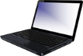

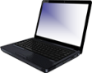








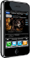




Elements of a wireless network
wired network
infrastructure
Book: Kurose and Ross: Wireless and Mobile Networks: 7- 32

Slide 33
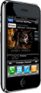

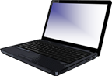
Elements of a wireless network
wireless hosts
laptop, smartphone, IoT
run applications
may be stationary (non-mobile) or mobile
wireless does not always mean mobility!
wired network
infrastructure
Book: Kurose and Ross: Wireless and Mobile Networks: 7- 33

Slide 34

Elements of a wireless network
base station
typically connected to wired network
relay - responsible for sending packets between wired network and wireless host(s) in its “area”
e.g., cell towers, 802.11 access points
wired network
infrastructure
Book: Kurose and Ross: Wireless and Mobile Networks: 7- 34

Slide 35
Elements of a wireless network
wireless link
typically used to connect mobile(s) to base station, also used as backbone link
multiple access protocol coordinates link access
various transmission rates and distances, frequency bands
wired network
infrastructure
Book: Kurose and Ross: Wireless and Mobile Networks: 7- 35

Slide 36

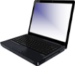


802.11 LAN architecture
Internet
wireless host communicates with base station
base station = access point (AP)
Basic Service Set (BSS) (aka “cell”) in infrastructure mode contains:
wireless hosts
access point (AP): base station
ad hoc mode: hosts only
switch
or router
BSS 1
BSS 2
Book: Kurose and Ross: Wireless and Mobile Networks: 7- 36

Slide 37
IEEE 802.11 Wireless LAN
IEEE 802.11 standard | Year | Max data rate | Range | Frequency
802.11b | 1999 | 11 Mbps | 30 m | 2.4 Ghz
802.11g | 2003 | 54 Mbps | 30m | 2.4 Ghz
802.11n (WiFi 4) | 2009 | 600 | 70m | 2.4, 5 Ghz
802.11ac (WiFi 5) | 2013 | 3.47Gpbs | 70m | 5 Ghz
802.11ax (WiFi 6) | 2020 (exp.) | 14 Gbps | 70m | 2.4, 5 Ghz
802.11af | 2014 | 35 – 560 Mbps | 1 Km | unused TV bands (54-790 MHz)
802.11ah | 2017 | 347Mbps | 1 Km | 900 Mhz
all use CSMA/CA for multiple access, and have base-station and ad-hoc network versions
Book: Kurose and Ross: Wireless and Mobile Networks: 7- 37

Slide 38
Lecture Summary

Slide 39
Mobile World ..
Number of Mobile subscription > 6.8 Billion
Number of mobile users: 4.1 Billion (60% of world’s population)
No more growth in subscription in developed world (almost 110% coverage)
75% GSM, 14% WCDMA/HSPA
India : 884 Million subscribers (73% population) : source – TRAI
Rapid growth expected in India, China, and developing countries
Mobile communication – Huge impact on our society – specially in developing countries
Enabling a common man
Significant impact on our productivity

Slide 40
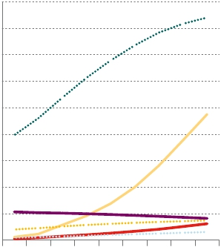
Fixed and Mobile Subscription
9,000
8,000
7,000
6,000
5,000
4,000
3,000
2,000
1,000
0
Source: Ericsson (2011)
Mobile
Subscription In Million
Mobile
Broadband
Voice
Fixed Broadband
Mobile PC
2008
2009
2010
2011
2012
2013
2014
2015
2016
Mobile subscriptions
Mobile broadband
Fixed narrowband voice
Fixed VoIP
Fixed broadband
Mobile PCs/tablets

Slide 41
Nielsen's Law of Internet Bandwidth
Users' bandwidth grows by 50% per year
10% less than Moore's Law for computer speed
The new law fits data from 1983 to 2019

